Slide 1
ConnectBud
Python
Class 5
By: Rahul Joshi

Slide 2
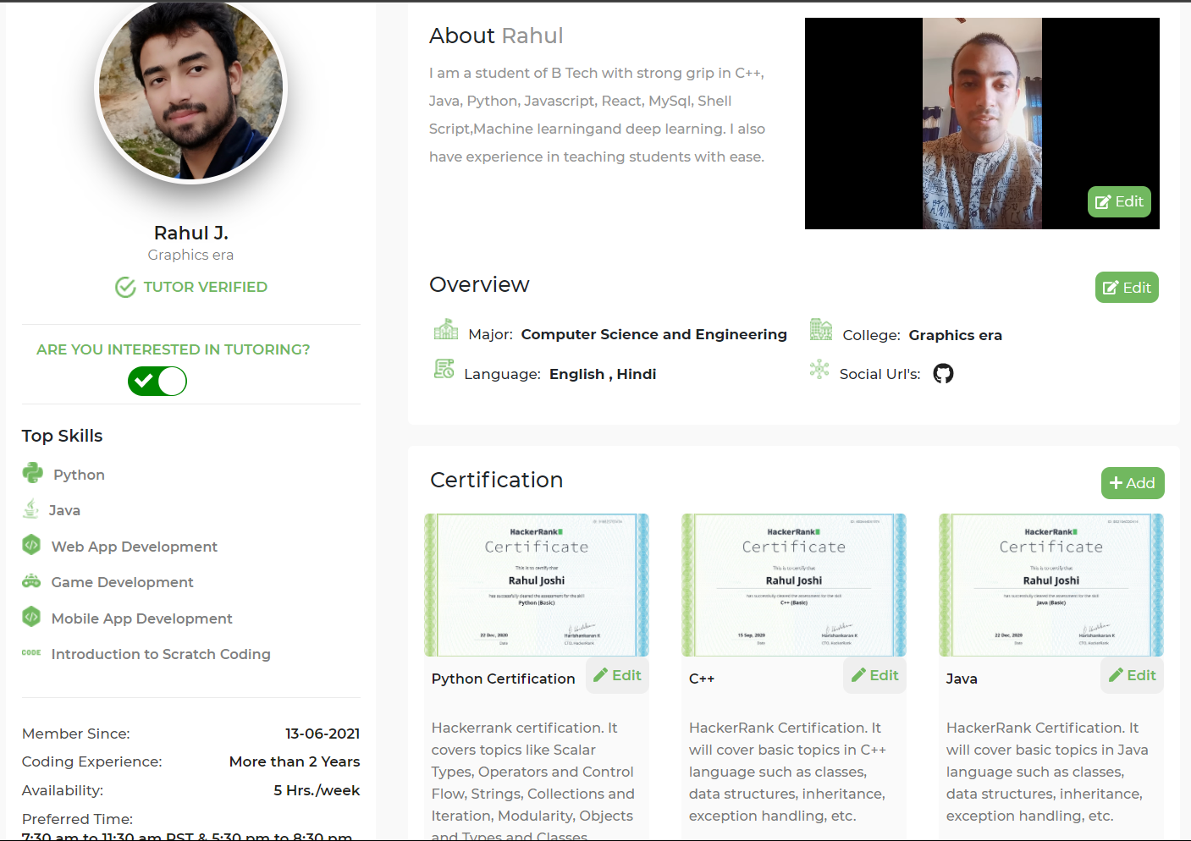

Slide 3
Class Overview
Class 4: • Input and Output.

Slide 4
Syntax
C1=input()

Slide 5
Example
print("Enter your details")
print("Provide your Name")
name=input()
print("Insert your age")
age=input()
print("Where do you study")
school=input()
print("Details:")
print("Name : ",name)
print("Age : ",age)
print("School : ",school)

Slide 6
Eg
name=input("enter your name : ")
print("Name inserted =" , name)
age=int(input("Enter your age"))
print("Age : ",age)
print(type(name))
print(type(age))
Print(type(11.5))
Age=int(input(“Enter your age”))
Print(“Enter your age”)
Wait for user to provide the input
User writes something
Int(string):
Convert the string to integer.
Value gets stored insode the container.

Slide 7
Task
Create a calculator :
Given the numbers and the operators as well.
Eg.
Num=20
Num2=30
Operator =+,-,*,/

Slide 8
End
For any queries: Contact:
Rahul Joshi rj26280218@gmail.com

